Slide 1
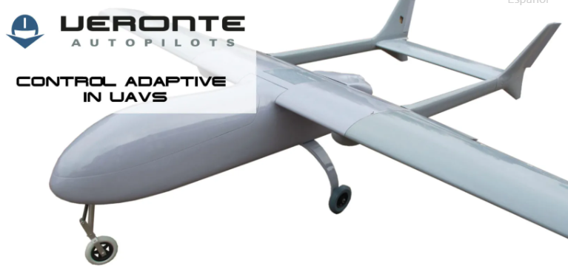
Robotics Hardware System
Title: Unmanned Aerial Vehicle (UAV)
Name: Mohamad Luqman Idlan bin Mohamad Azahari
Matric: 1723539

Slide 2
Main components
1. Design
2. Navigation and control system
3. Propulsion system
4. Data Collection
5. Data Transmission
6. Power Management

Slide 3
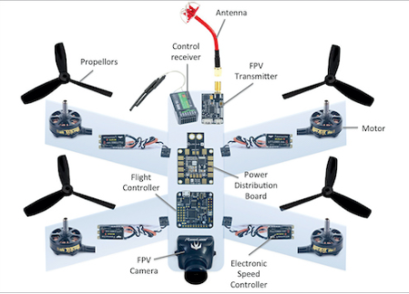
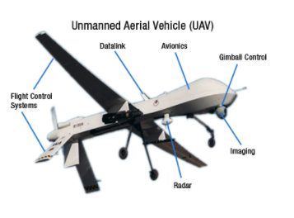
Design

Slide 4
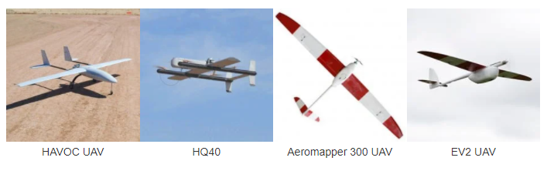
Fixed-Wing Unmanned Aerial Vehicles
1. Extended flight Endurance
2. Heavy payload capacity
3. Configurable payloads
4. BLOS capabilities

Slide 5
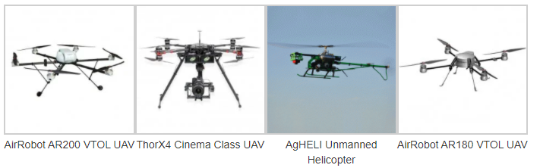
Multi-Rotor Unmanned Aerial Vehicles
1. Medium flight endurance
2. Heavy lift capacity
3. Configurable payloads
4. LOS capabilities

Slide 6
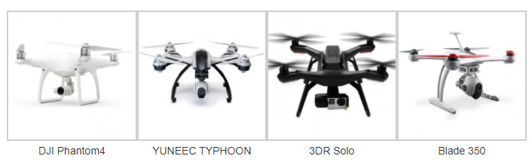
Drones
1. 30+ minute flight endurance
2. Ready-to-fly
3. Smaller payload capacity
4. LOS capabilities

Slide 7
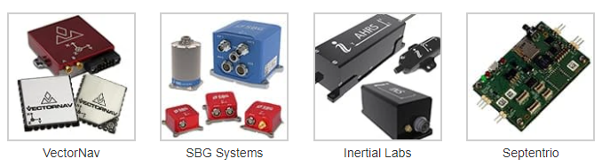
Sensors
1. Small, lightweight and low power consumption
2. Cm-level (RTK) and dm-level (PPP) position accuracy

Slide 8
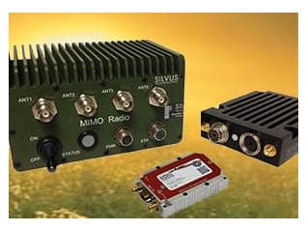
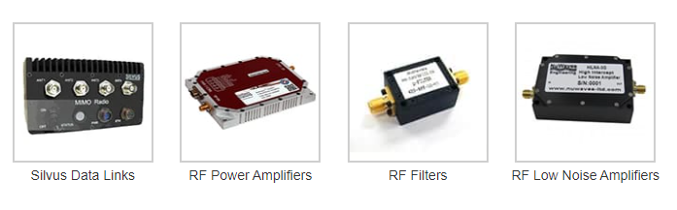
Navigation and Communication for control system
1. Silvus technologies offer communications solutions from high bandwith video and telemetry data.
2. High speed data and high resolution video transfers in unpredictable environments.
3. provide a self-healing, self-forming mesh network that self-optimizes, requiring no operator involvement

Slide 9
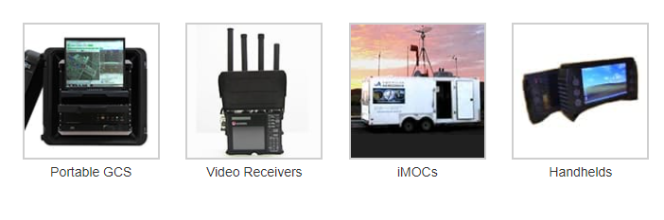
Control system
1. GCS is responsible for controlling unmanned vehicles and payloads.
2. Installed application allows easy configuration of UAV
3. monitor measurement and sensing equipment
4. Robust and can be used in harsh environment

Slide 10
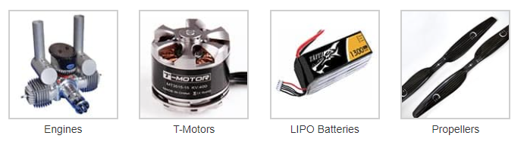
Propulsion System
1. Provide lift for the aircraft by spinning and creating an airflow, which results in a pressure difference between the top and bottom surfaces of the propeller.
2. Propeller speeds are varied by changing the voltage supplied to the propeller’s motor, a process that is handled by an Electronic Speed Controller (ESC).
3. Drone propellers can be constructed with two, three, or four blades.
4. Propellers with more blades provide greater lift due to more surface area moving through the air per rotation, but are more inefficient due to increased drag.
5. Drone propeller blades are most commonly constructed from plastic or carbon fiber.

Slide 11
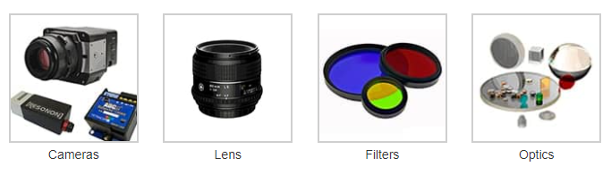
Data Collection
1. Data is collected from image system of machine vision camera
2. Lightweight camera with small footprints
3. Imaging filters and lens hardware

Slide 12
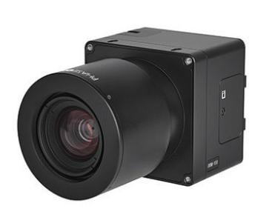
IXM-series cameras
1. provide superior-quality sharp aerial imagery for UAV-based applications.
2. full wireless control, allowing users to easily define ISO, shutter speed, aperture, focus distance.
3. HDMI output as well as USB-C and 10G Ethernet data connectivity provide versatile integration options for a variety of UAV platforms.

Slide 13
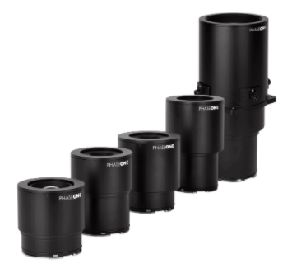
IXM lens
1. Electronic charging that increases exposure speed up to 1/2500s, with a lifespan of 500,000 exposures.
2. Allow aerial imaging drones to fly faster and execute demanding aerial photography missions with greater operational efficiency.
3. Five RSM lenses are available, with focal lengths of 35mm, 80mm, 150mm and 300mm.

Slide 14
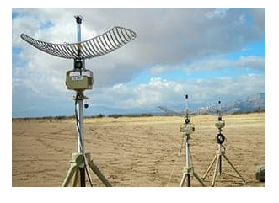
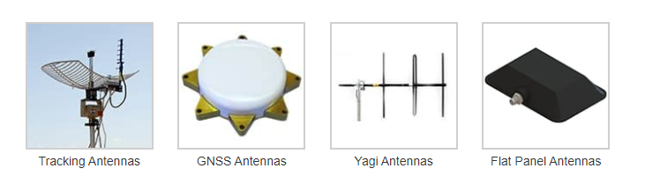
Data Transmission
1.Antennas are used for data recording and transmission and avionic functions.
2. Allow information transmission to other systems and people on ground.
3. Ground-to-ground, Ground-to-air, air-to-ground.

Slide 15
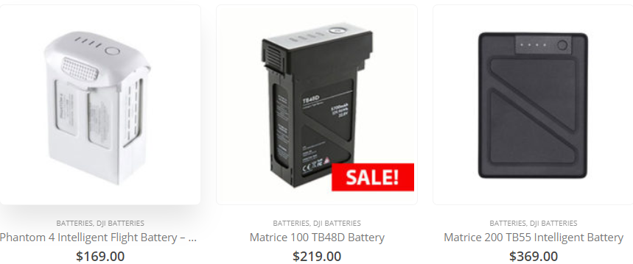
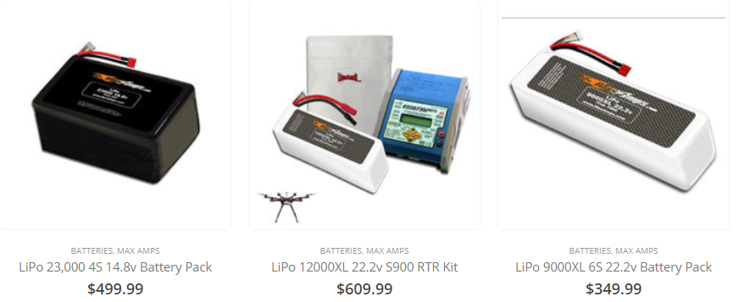
Power Management
1. LiPo batteries provide longer flight times
2. Lower weight
3. Sharper flexibility
4. Higher capacity
5. Higher discharge rate
6. Deliver more power
7. LiPo batteries are hardly self discharge. It can be stored up to 1-2 months and still function well
8. Rechargeble
9. Volatile and potential fire hazard

